Slide 1
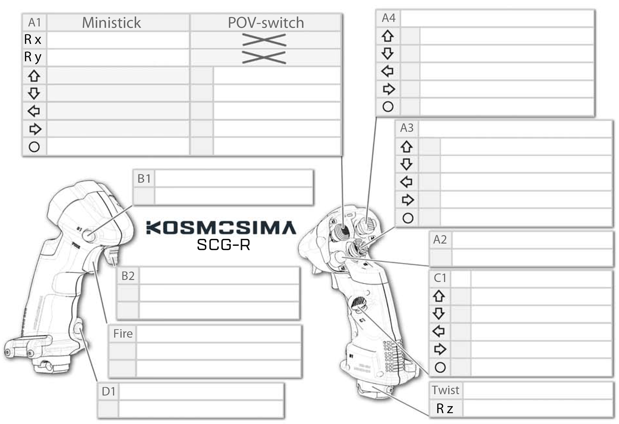

Red Light On
No Light On
Trim Adjustment Switch (Yaw and Pitch Axes)
Move Stick Left/Right
Cockpit View Yaw Axis (Reversed)
External View Yaw Axis
6
Elevator Trim Up (Nose Up)
Move Stick Up/Down
Cockpit View Pitch Axis
External View pitch Axis (Reversed)
8
Elevator Trim Down (Nose Down)
POV⬆
Increase Cockpit View Height
9
Aileron Trim Left
POV⬇
Decrease Cockpit View Height
7
Aileron Trim Right
POV⬅
Translate Cockpit View Left
10
POV➡
Translate Cockpit View Right
Castle Switch
Change to POV-switch Mode 👉🏻
👈🏻 Change to Ministick Mode
11
Cockpit Quickview Up
External Quickview Top
13
Cockpit Quickview Rear
External Quickview Rear
Index Finger Button
14
Cockpit Quickview Left
External Quickview Left
4
12
Cockpit Quickview Right
External Quickview Right
Base / Gimbal
Lx / Ax (Lean Stick Left/Right) | Ailerons Axis
Ly / Ay (Lean Stick Forward/Backward) | Elevator Axis
15
“Pickle Button”
3
Toggle Smart Camera
Secondary Trigger
Lower Thumb Button
Forward
26
Cockpit/ External View Mode
Forward
23
Translate Cockpit View Forward
Backward
27
Cockpit/ External View Mode
Backward
21
Translate Cockpit View Backward
Primary Trigger
24
In
1
Toggle Active Pause
22
In+
2
25
Reset Cockpit View
Reset External View
Pinkie Button
5
Rudder Axis
Notes:
A2 is called “the pickle button” and is conventionally used for weapons employment
A3 is conventionally-used for interaction with displays (up/down/left/right/select UI navigation)
A4 is conventionally-used for trim adjustments

